Slide 1
Conduction disturbances following surgical aortic valves replacement with rapid-deployment bioprosthesis
Coti I et al. J Thor Cardiovas Surg. 2020;
doi: 10.1016/j.jtcvs.2020.01.083

Slide 2
Study details
Aim: To assess postoperative conduction disturbances in patients who have undergone RD-AVR with the EDWARDS INTUITY valve system, and to determine underlying risk factors that lead to PPI
Study type: Prospective, single-centre, real-world experience
Endpoints:
Primary endpoint:
Early PPI after RD-AVR
Secondary endpoints:
Overall occurrence of PPI
New-onset conduction disturbances (atrioventricular or intraventricular)
Mortality

Slide 3
Study details (1/2)
Methods:
663 patients underwent RD-AVR between May 2010 and April 2019 in a prospective database
Patients with pre-existing pacemakers were excluded
Electrocardiography was used to assess conduction disturbances during the procedure at 3 months and 1, 3 and 5 years, postoperatively
Clinical follow-up by telephone interviews: 2, 4 and 7 years, postoperatively
Median follow-up: 20 months (IQR 11─41 months; total duration up to 9 years)

Slide 4
Study details (2/2)
Methods:
Univariate and multivariate logistic regression analyses were used to identify baseline PPI predictive factors in the first 14 days following surgery
These analyses included the following variables:
Age
Valve size
Concomitant procedures
Concomitant CABG
Conduction anomalies at baseline

Slide 5
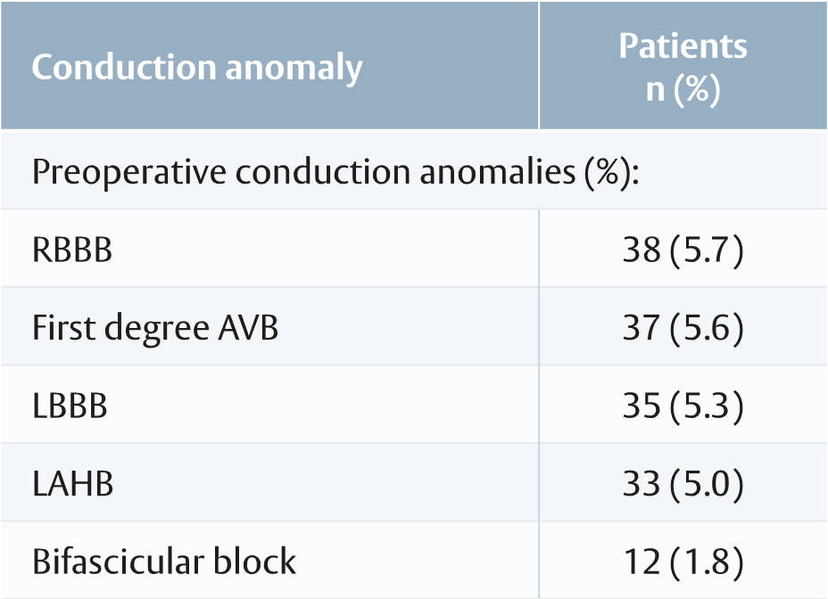
Key study results (1/3)
Patient characteristics
Average patient age was 73.4 ± 7.8 years
45.2% patients were female
Preoperative conduction disturbances: 126 patients (19.0%)
Mean EuroSCORE II was 2.3%
Adapted from Coti et al.

Slide 6
Key study results (2/3)
Survival analysis
PPI did not significantly affect survival
Survival was similar in patients who required PPI in the first 14 days after RD-AVR, and in the patients who did not require it (p=0.60)
Postoperative survival rates after early PPI: 98%, 86% and 82% at 1 year, 3 years and 5 years
Postoperative bundle branch block
LBBB before discharge occurred in 206 (31.1%) patients
LBBB was transient in 36 (5.4%) of these patients
RBBB before discharge occurred in 11 (1.7%) patients

Slide 7
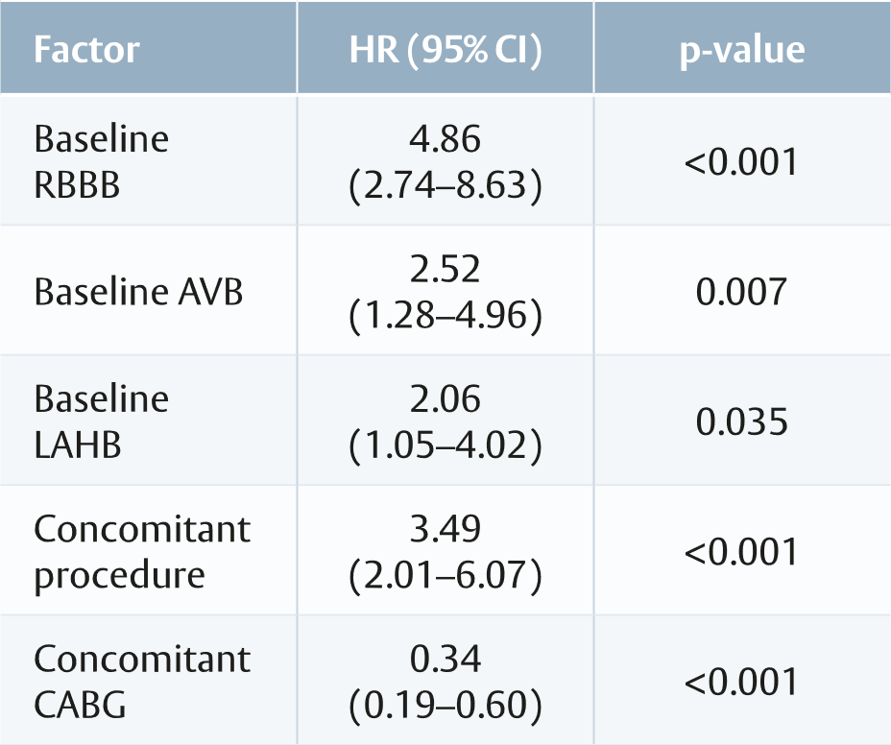
Key study results (3/3)
PPI analysis
In the first 14 days after RD-AVR, 61 patients required PPI
Of these patients, 34 (5.1%) had no baseline conduction disturbances
In the first 30 days after RD-AVR, 68 patients (10%) required PPI
Overall, 80 patients required PPI during the complete follow-up period
Cumulative incidence of PPI was 9.4%, 10.3%, 11.7% and 15.3% at 14 days, 30 days, 1 year and 5 years, postoperatively
Independent predictors of PPI
Adapted from Coti et al.

Slide 8
Study limitations and conclusion
Limitations
Combines both pre-market clinical trial and post-market registry data
Variance in the inclusion criteria potentially leading to a non-homogenous patient population
The rate of PPI may be reduced by exclusion of patients with baseline conduction anomalies
Conclusion
This study shows that nearly half of patients who required PPI in the first 14 days after RD-AVR presented with various baseline conductions disturbances. In these patients, RBBB was an independent predictor for increased PPI. At early- and intermediate-follow-ups, PPI or new-onset LBBB did not significantly affect survival. The authors recommend improvements in patient selection and surgical methods to achieve better outcomes after RD-AVR

Slide 9
This document is a summary of the Coti I et al. paper and covers key information including aim, type of study, methods, results, limitations and conclusions.
The full publication is available at: https://bit.ly/2Kr2pRZ
Abbreviations
AVB: atrioventricular block
CI: confidence interval
CABG: coronary artery bypass grafting
EuroSCORE II: European System for Cardiac Operative Risk Evaluation II score
HR: hazard ratio
IQR: interquartile range
LAHB: left anterior hemiblock
LBBB: left bundle branch block
PPI: permanent pacemaker implantation
RD-AVR: rapid deployment aortic valve replacement
RBBB: right bundle branch block
Important safety information:
Use of the EDWARDS INTUITY Elite valve system may be associated with new or worsened conduction disturbances, which may require a permanent cardiac pacemaker implant (PPI). The rate of PPI for the EDWARDS INTUITY Elite valve is within the range reported in the literature for various rapid deployment valves, but higher than that reported for surgical aortic valves. Physicians should assess the benefits and risks of the EDWARDS INTUITY Elite valve prior to implantation. See instructions for use for additional information.
For professional use. For a listing of indications, contraindications, precautions, warnings, and potential adverse events, please refer to the Instructions for Use (consult eifu.edwards.com where applicable).
Edwards devices placed on the European market meeting the essential requirements referred to in Article 3 of the Medical Device Directive 93/42/EEC bear the CE marking of conformity.
Edwards, Edwards Lifesciences, the stylized E logo, Carpentier-Edwards, EDWARDS INTUITY, and EDWARDS INTUITY Elite are trademarks or service marks of Edwards Lifesciences Corporation or its affiliates. All other trademarks are the property of their respective owners.
© 2020 Edwards Lifesciences Corporation. All rights reserved. PP--EU-0180 v1.0

